Slide 1
375 Project Proposal
Shanley Mullen and Jesse Rosart-Brodnitz

Slide 2
VCR
Project Plan
Distribution of Work
Timeline
Outcome

Slide 3
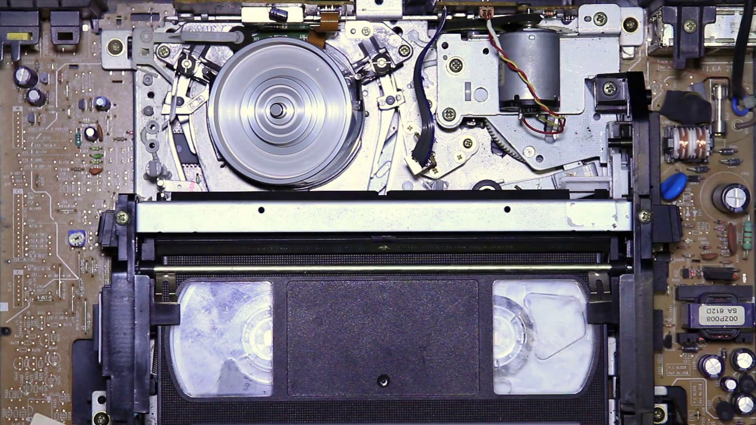
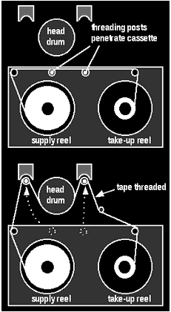

Slide 4
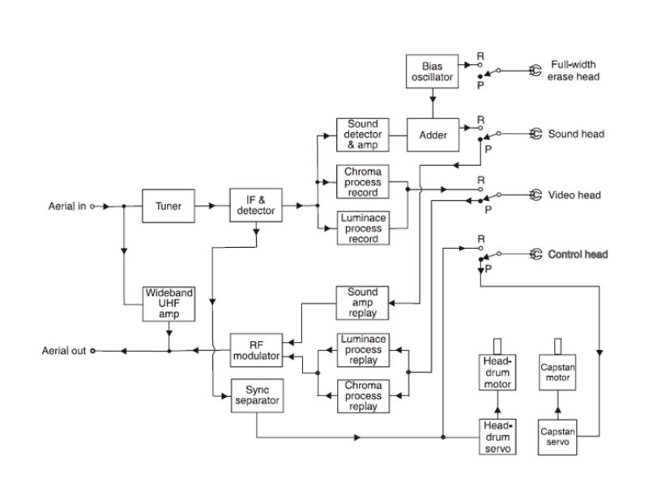

Slide 5
Plan
FIRST STEP
Use (and disassemble) a VCR to test each component.
Third STEP
Relate image quality and stability to time, video playback, and energy consumption.
Relate the RPM, springs, etc. of the subsystems to find the energy of the system.
Second STEP
Create VCR components in Simulink.

Slide 6
TIMELINE
Week 1
Project proposal. The Planning Stage.
Weeks 3&4
Modeling components in Simulink and comparison to real world data.
March
April
17th-23th
24th-31st
1st-13th
14th-20th
March
April
Week 2
Start simulation.
Do real world testing and disassemble the VCR.
Week 5
Final Presentation preparation.

Slide 7
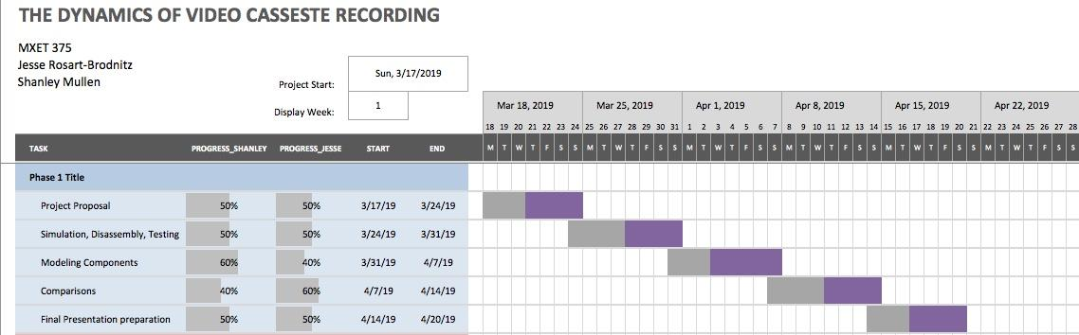
Breakdown

Slide 8
Goals
1
2
3
A simulation that shows components of a fully functioning VCR.
Creating(using data) and solving equations that relate the system to energy consumption.
Be able to compare image quality and stability to time, playback, and energy consumption.

Slide 9
Questions?

